Slide 1
Genetic Circuits
ECE 424/524 Etc.

Slide 2
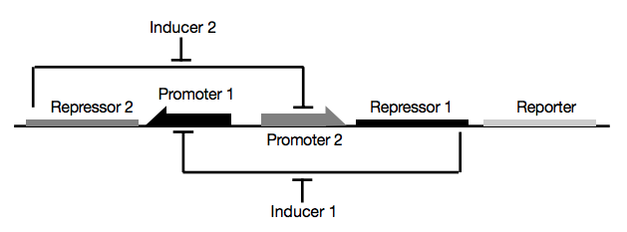
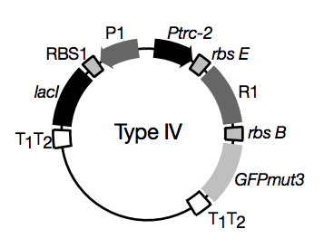
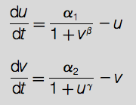
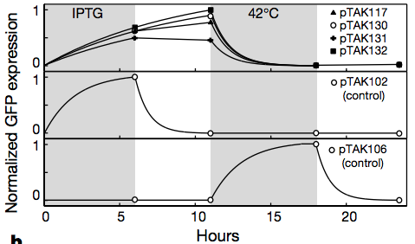
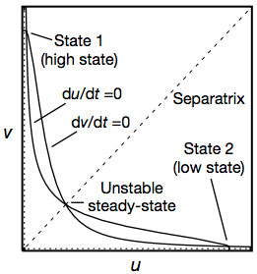
Gardner, Cantor and Collins, 2000

Slide 3
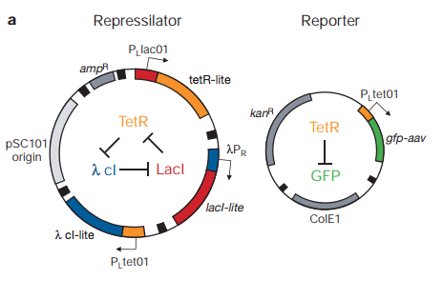
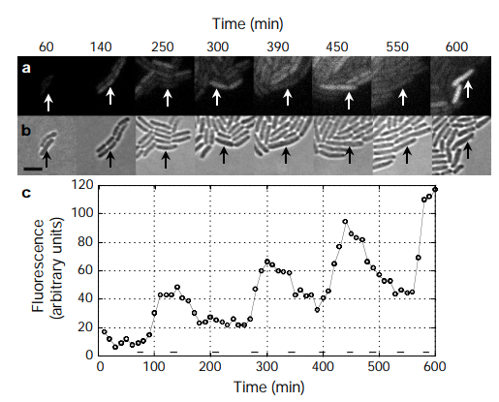
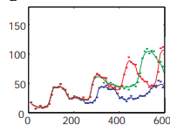
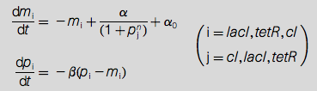
Elowitz and Leibler, 2000

Slide 4
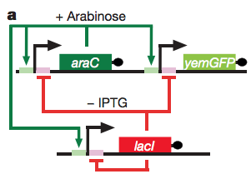
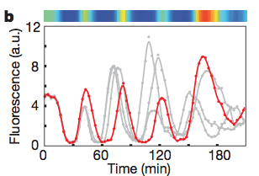
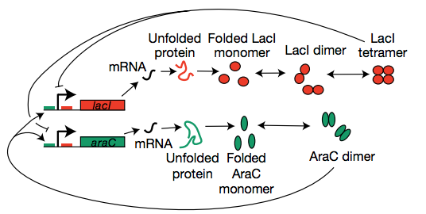
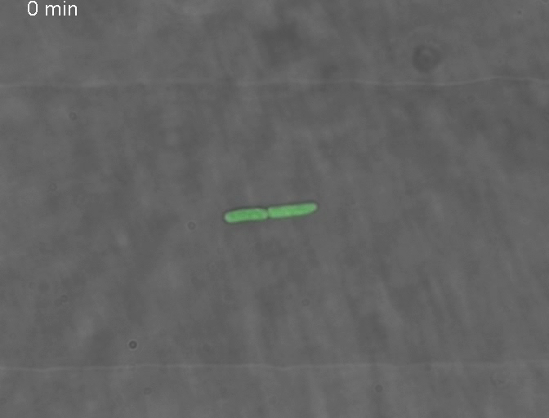
Stricker, Cookson, Bennet, Mather, Tsimring and Hasty, 2008

Slide 5
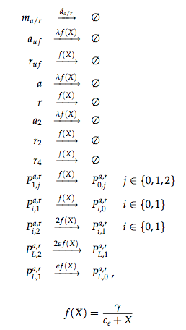
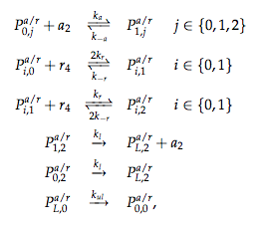
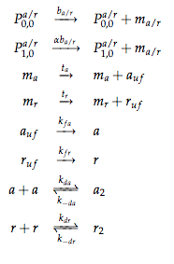
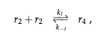

Slide 6
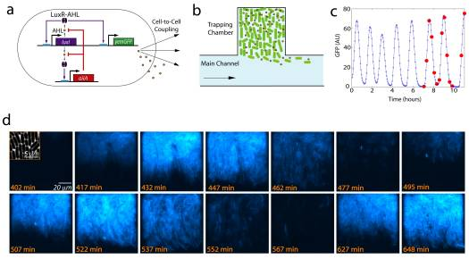
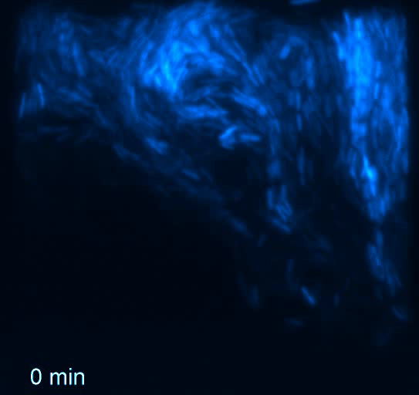
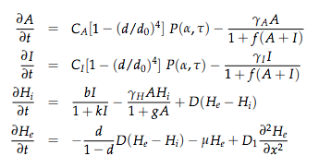
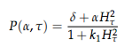
Danio, Palomino, Tsimring, and Hasty, 2010

Slide 7
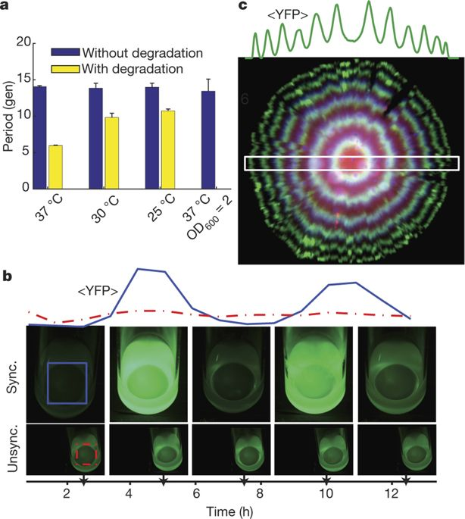
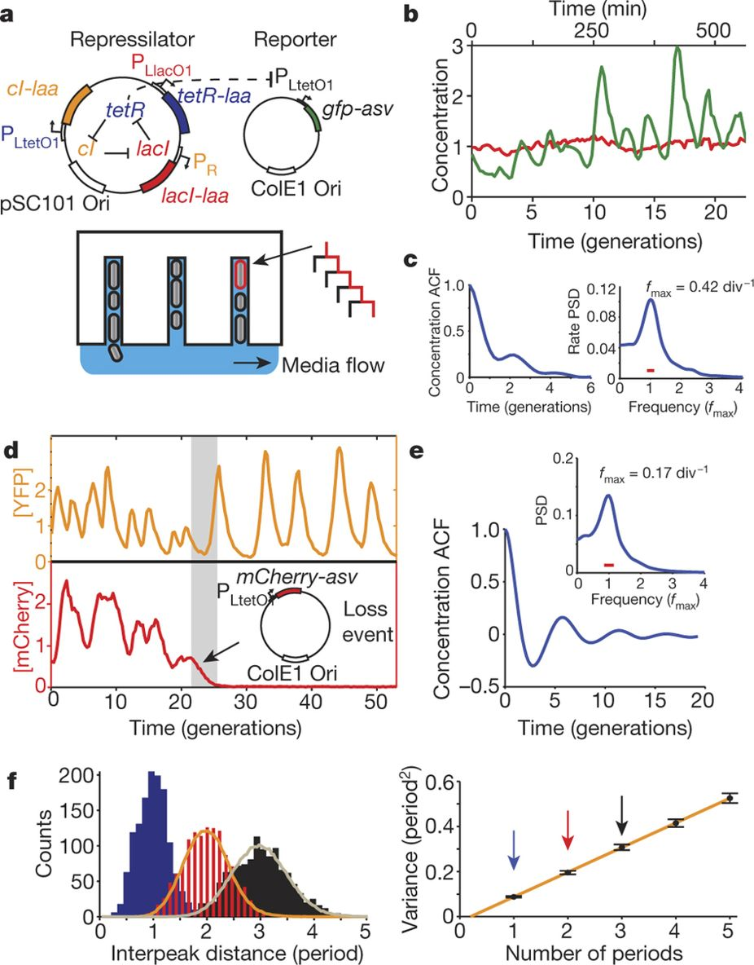
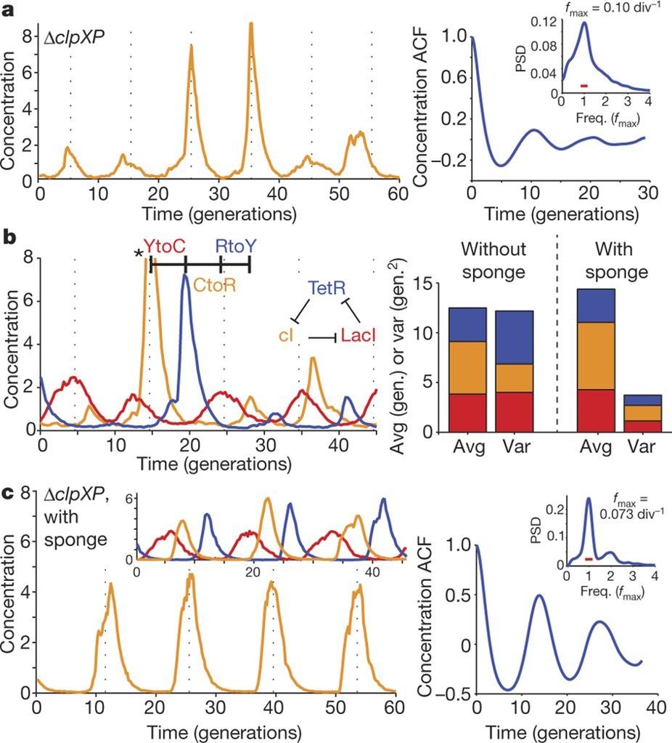
Trottier, Lord, Vinnecombe, and Paulsson, 2016
Original
Integrated
No coupling!
Put everything on one plasmid
Remove degradation tags
Raise threshold of TetR by adding “sponge sites”

Slide 8
Boolean Logic

Slide 9
The Ideal Transcription Factor
Effector
Sensing
Cooperativity
DBD
Modular fusion of protein domains
Effector: Activation, repression, chromatin remodeling
Sensing: degrons, nuclear localization, phosphorylation
Cooperativity: domain for multimerization increases switch-like behavior
DBD: Readdressible DNA Binding domain

Slide 10
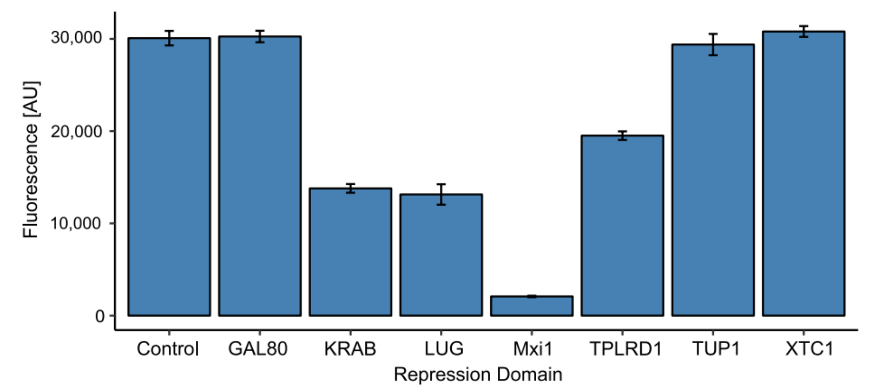
Repression Domains in Yeast
Gander, Vrana, Voje, Carothers, and Klavins. 2016.

Slide 11
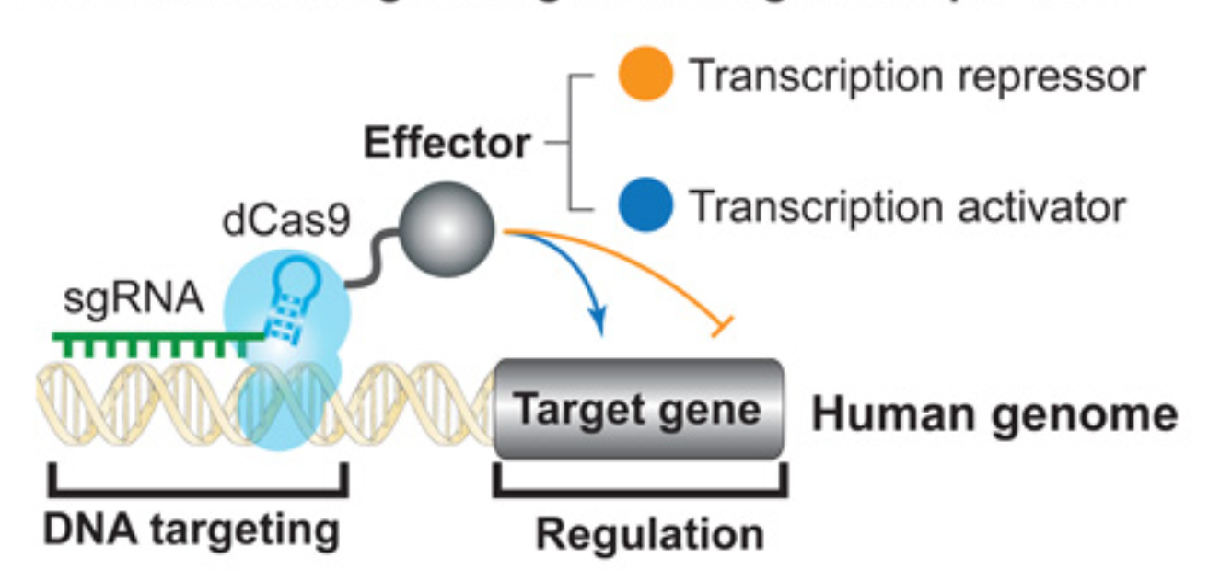
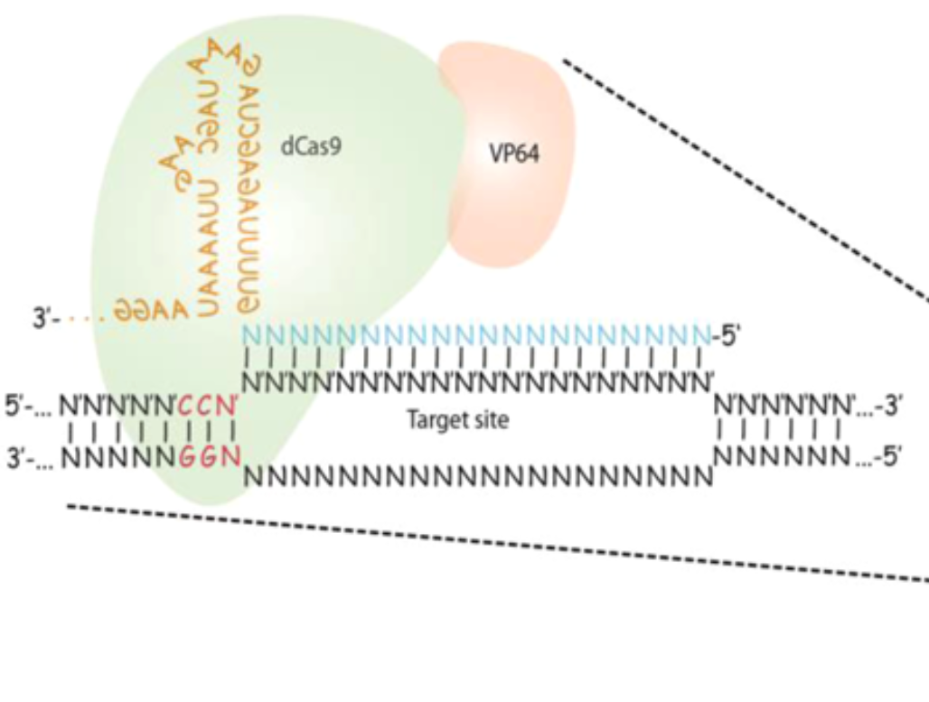
dCas9 as an Addressable DBD
Cell. 2013 Jul 18;154(2):442-51.
CRISPR-mediated modular RNA-guided regulation of transcription in eukaryotes.
Gilbert LA¹, Larson MH, Morsut L, Liu Z, Brar GA, Torres SE, Stern-Ginossar N, Brandman O, Whitehead EH, Doudna JA, Lim WA, Weissman JS, Qi LS.
ACS Synth. Biol., 2013, 2 (10), pp 604–613
Tunable and Multifunctional Eukaryotic Transcription Factors Based on CRISPR/Cas
Fahim Farzadfard, Samuel D. Perli and Timothy K. Lu
Got activation and repression from an AD

Slide 12
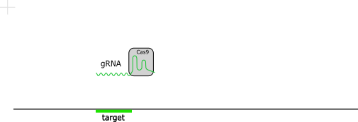
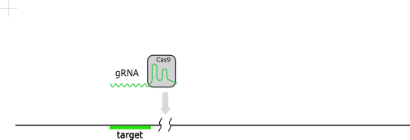
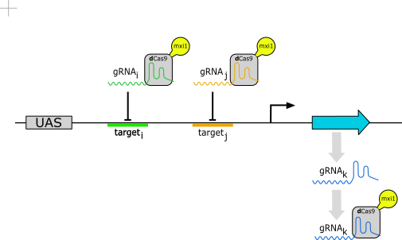
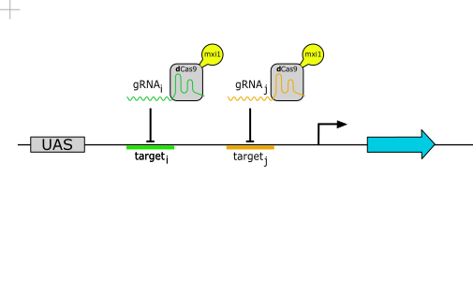
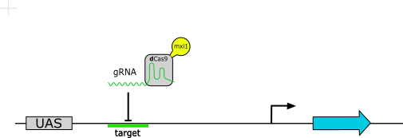
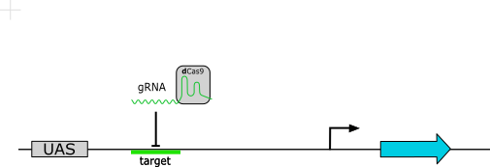
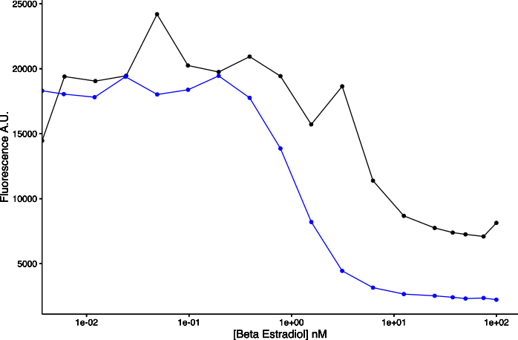
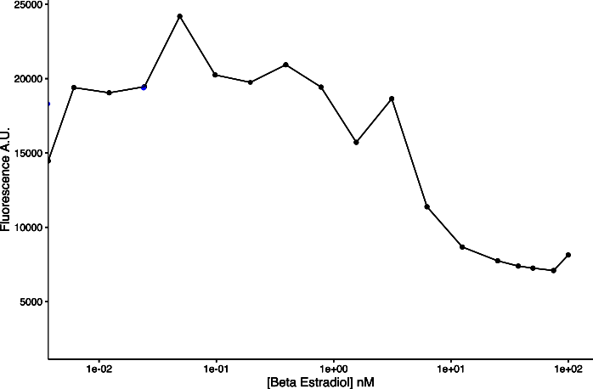
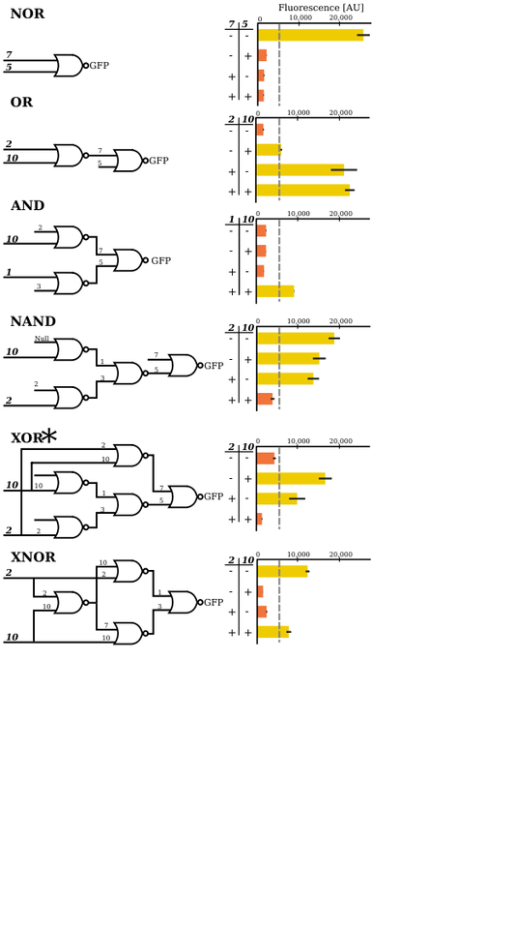
Modular, Genetic NOR Gates
Fluorescence
Fluorescence
gRNA Induction
gRNA Induction
i j k
00 1
01 0
0
0
i
j
k
Gander, Vrana, Voje, Carothers, and Klavins. 2016.
Compare to Nielsen et al, 2016.

Slide 13
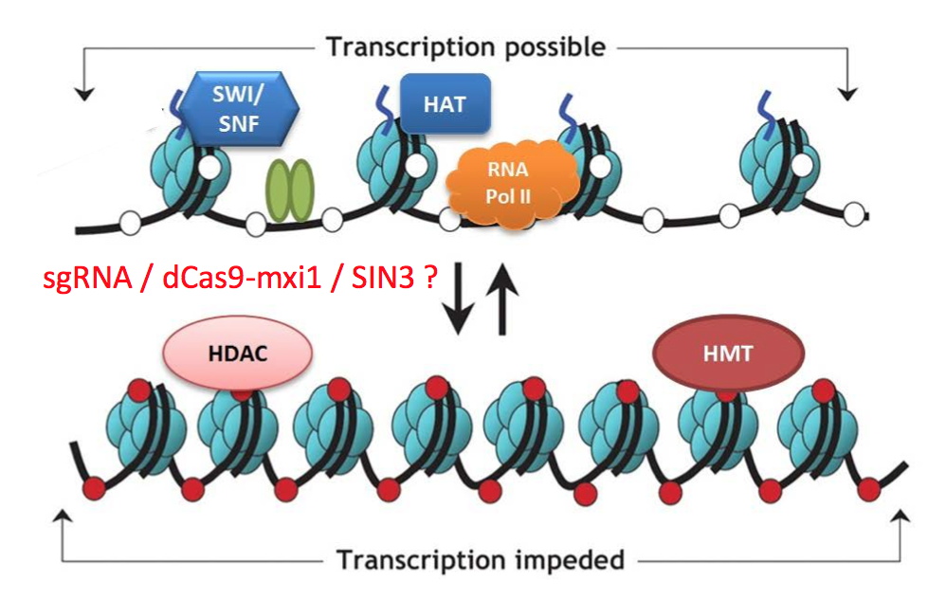
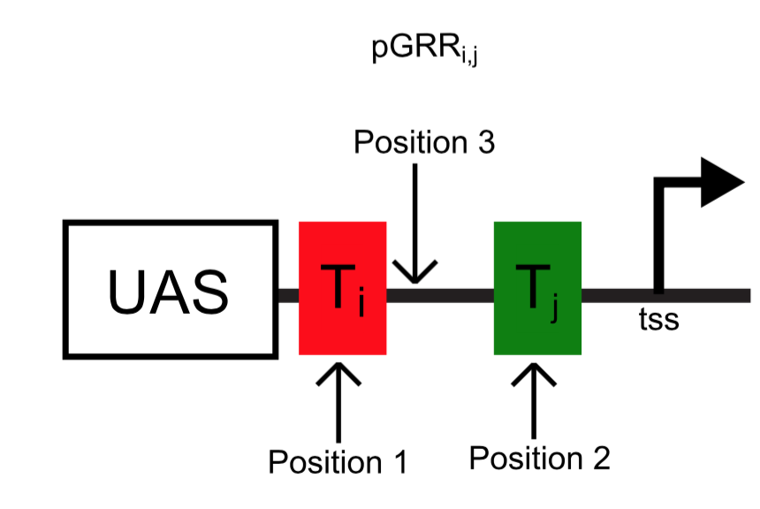
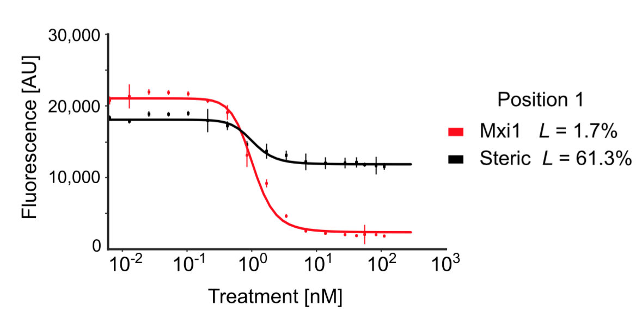
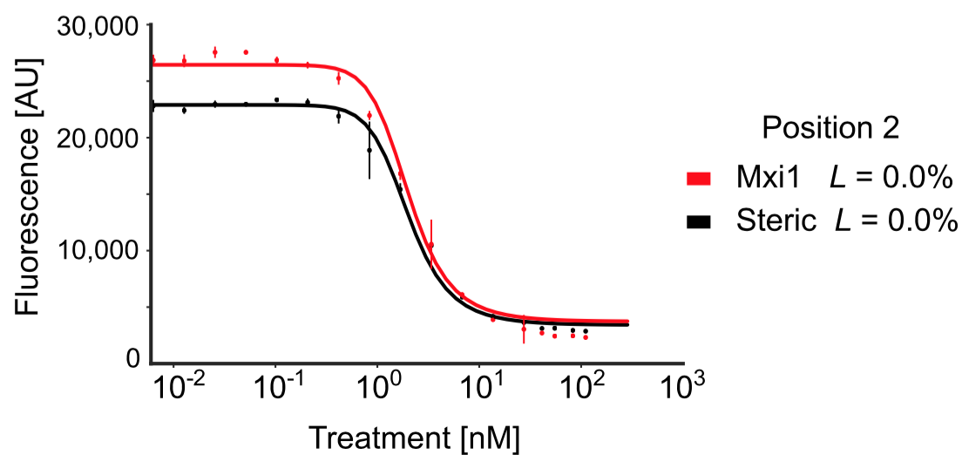
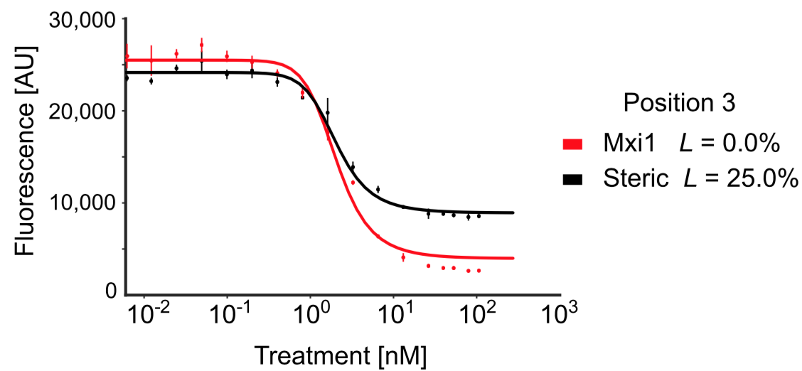
Engineering digital signals
Notes:
HDAC=repression Histone de-acytlase tightens chromatin and retricts access to transcription machinery

Slide 14
Compatible input and output
gRNA expressed from Pol II promoters using ribozyme flanked transcripts
Gao, Yangbin, and Yunde Zhao. "Self‐processing of ribozyme‐flanked RNAs into guide RNAs in vitro and in vivo for CRISPR‐mediated genome editing." Journal of integrative plant biology 56.4 (2014): 343-349.
Notes:
Gao paper cite.
----- Meeting Notes (1/12/16 16:18) -----
get rid of mxi1 here

Slide 15
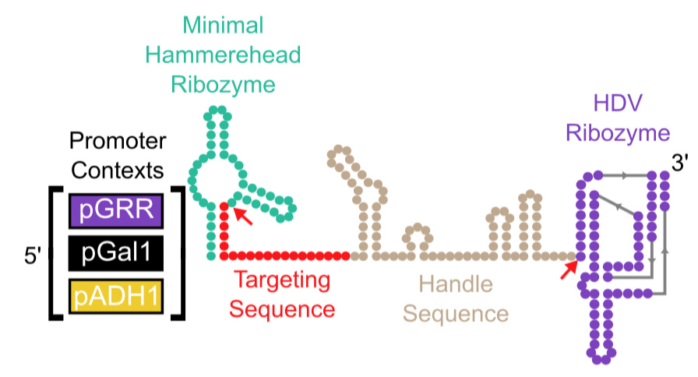
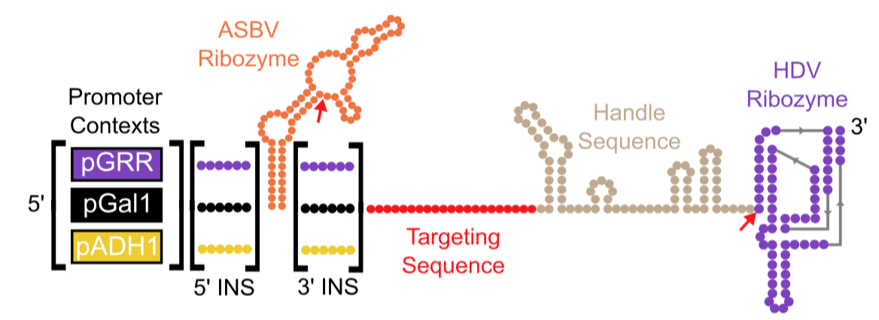
Compatible input and output
RGR
Insulated RGR
Notes:
We explored 2 types of RGR systems

Slide 16
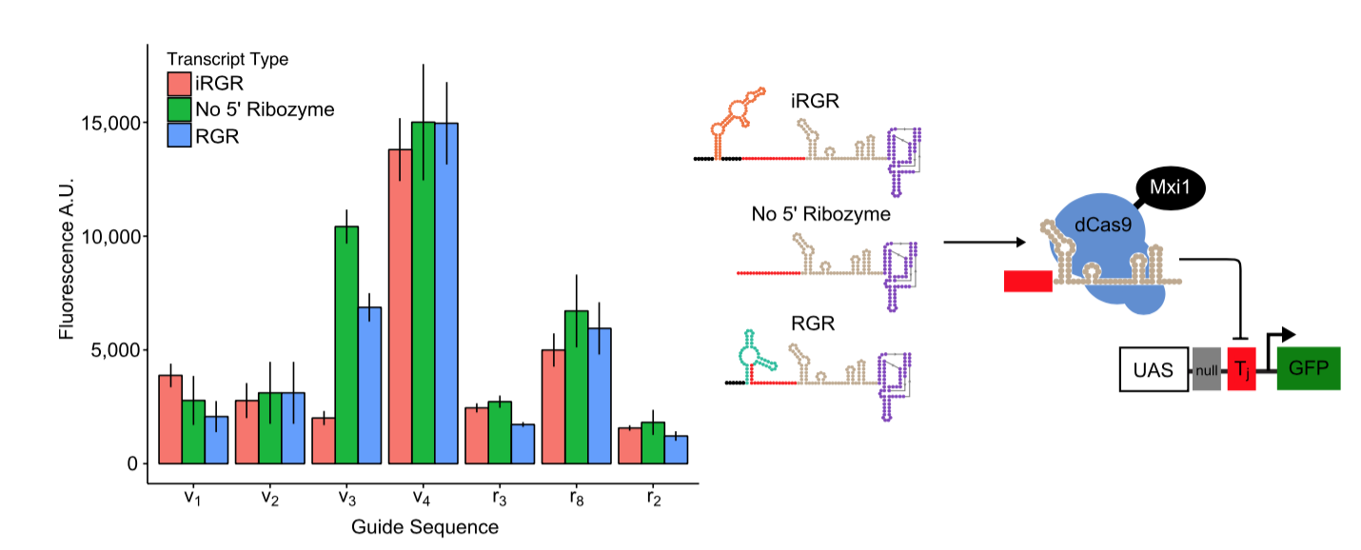
Compatible input and output
iRGR and RGR seem to function similarly in most cases
The 3’ HDV ribozyme is the most important to function
Notes:
We found that our two RGR systems functioned simlarly and that the most important ribozyme was the 3’ HDV which removes the poly a tail

Slide 17
Wiring using dCas9
20 orthogonal wires
Programmability of gRNA sequence allows arbitrary targeting of dCas9 to promoter sequences
Notes:
Three big take aways,
dCas9 binds to a small RNA called a gRNA
Each gRNA has a 20bp sequence that binds to it’s DNA complement
By changing the 20bp sequence we can aribtrarily target dCas9 to any promoter sequence we desire
Make sure to say that promoter target sequence is programable
Havent told you what is causing repression but the black means it targeting and the grey means it isntt

Slide 18
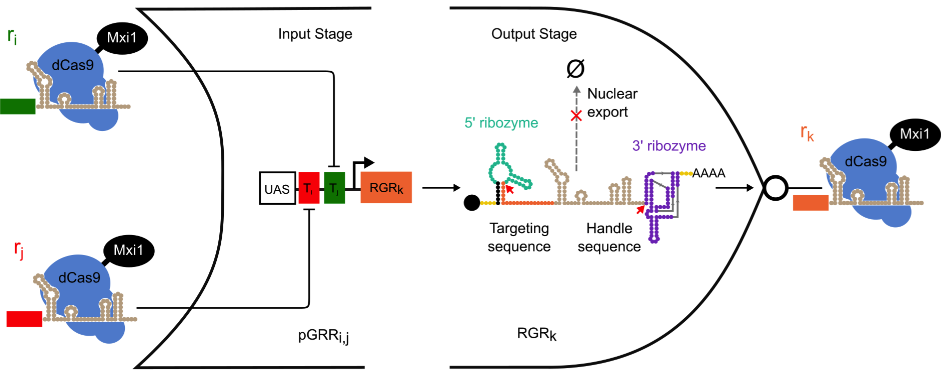
NOR Gate Library
NOR Gates are functionally complete
20 guide sequence library 400 promoter variants x 20 gRNA = 8000 gates

Slide 19
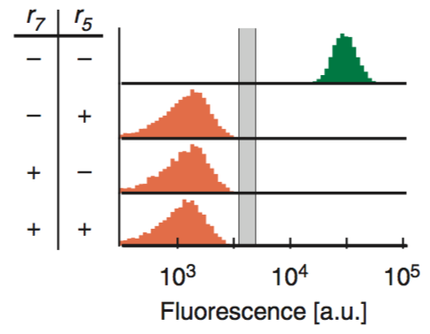
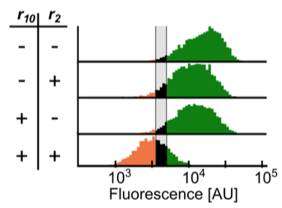
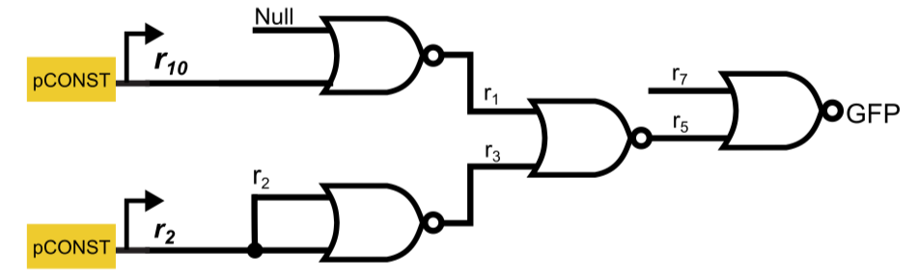
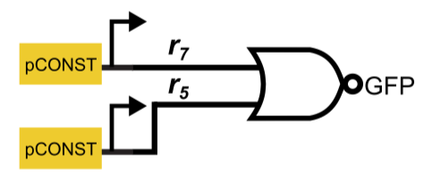
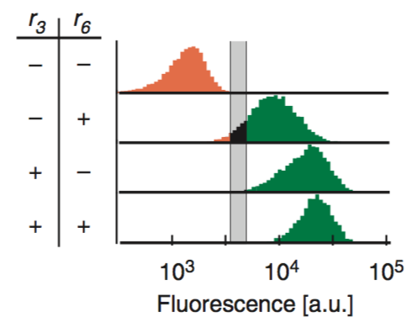







Constructing Logic Circuits
NOR
NAND
0
0
1
1
0
1
0
0
0
0
1
1
1
0
0
1
0
1
1
1
0
1
1
0
OR
XNOR
0
0
0
0
0
1
0
1
1
0
1
0
1
0
1
1
0
0
1
1
1
1
1
1
AND
XOR
0
0
0
0
0
0
1
0
1
0
0
1
1
0
0
1
0
1
1
1
1
1
1
0

Slide 20

Performance Variation of Circuits
William Voje, James Carothers, in progress.
Similar to Nilssen et al
Notes:
So here is 15 of the most recetly made XOR gates. The one with the red astericks is the one currently used in the paper but check out all the variation. And this is just about primarily changing the promtoers of the circuits

Slide 21
Repression Cascades
7 total gRNA layered in a repression cascade
Notes:
Make a joke about the 6th

Slide 22



Cascade Analysis
Notes:
Put in minutes per layer

Slide 23

In Plants
Arjun Khakhar, Eric Klavins and Jennifer Nemhauser, to be submitted

Slide 24

Visualizing Hormones in Plants
Arjun Khakhar, Eric Klavins and Jennifer Nemhauser, to be submitted
Root tip
Lateral roots
Developing root
primordia
Notes:
Figure 2: HACRs respond to endogenous hormone signals and can be used to study development. A) Schematic of genetic circuit used to build ratiometric lines of auxin responsive HACRs. In addition to an auxin responsive HACR regulating a nuclear localized Venus-luciferase reporter the lines also have a nuclear localized ndTomato reporter being driven by a version of the UBQ1 promoter with the gRNA target site mutated. B-E) Confocal microscopy images of roots of seedlings from lines described in A. Reporter signal in images is the background subtracted Venus signal normalized by the background subtracted ndTomato signal. Warmer colors correspond to higher normalized reporter signal. The dashed white boxes highlight high reporter signal in the founder cells of lateral roots (D) and in a developing lateral root primordia (E). F-J) Confocal microscopy images visualizing reporter signal of a non-ratiometric auxin HACR regulated reporter in the ovule 48 hours post pollination (F), in the two-cells embryo (G), in the globular embryo (H), in the heart stage embryo (I) and in the early torpedo stage embryo (J). Warmer colors correspond to higher reporter signal. K-M) Confocal microscopy images visualizing reporter signal of a gibberellin HACR regulated reporter in the ovule 48 hours post pollination (K), reporter signal merged with background red fluorescence to highlight the endosperm region (L) and an unregulated reporter (M), with the endosperm highlighted with a dashed white line, for comparison.

Slide 25
Visualizing Hormones in Plants
Arjun Khakhar, Eric Klavins and Jennifer Nemhauser, to be submitted
Ovule (48 hrs)
Two-cells embyro
Globular embyro
Heart stage
Ovule
Jasmonate regulated reported
Note: Jasmonate levels increase in damaged tissue.
In progress: Connecting output to developmental genes.
Leaves
Notes:
Figure 2: HACRs respond to endogenous hormone signals and can be used to study development. A) Schematic of genetic circuit used to build ratiometric lines of auxin responsive HACRs. In addition to an auxin responsive HACR regulating a nuclear localized Venus-luciferase reporter the lines also have a nuclear localized ndTomato reporter being driven by a version of the UBQ1 promoter with the gRNA target site mutated. B-E) Confocal microscopy images of roots of seedlings from lines described in A. Reporter signal in images is the background subtracted Venus signal normalized by the background subtracted ndTomato signal. Warmer colors correspond to higher normalized reporter signal. The dashed white boxes highlight high reporter signal in the founder cells of lateral roots (D) and in a developing lateral root primordia (E). F-J) Confocal microscopy images visualizing reporter signal of a non-ratiometric auxin HACR regulated reporter in the ovule 48 hours post pollination (F), in the two-cells embryo (G), in the globular embryo (H), in the heart stage embryo (I) and in the early torpedo stage embryo (J). Warmer colors correspond to higher reporter signal. K-M) Confocal microscopy images visualizing reporter signal of a gibberellin HACR regulated reporter in the ovule 48 hours post pollination (K), reporter signal merged with background red fluorescence to highlight the endosperm region (L) and an unregulated reporter (M), with the endosperm highlighted with a dashed white line, for comparison.

